Slide 1
Chapter 4
How to retrieve data from two or more tables

Slide 2
Objectives
Applied
Use the explicit syntax to code an inner join that returns data from a single table or multiple tables.
Use the explicit syntax to code an outer join.
Code a union that combines data from a single table or multiple tables.

Slide 3
Objectives (continued)
Knowledge
Explain when column names need to be qualified.
Describe the proper use of a table alias.
Describe the differences between an inner join, a left outer join, a right outer join, a full outer join, and a cross join.
Describe how to combine inner and outer joins.
Describe the use of the implicit syntax for coding joins.
Describe the use of the USING and NATURAL keywords for coding joins.

Slide 4
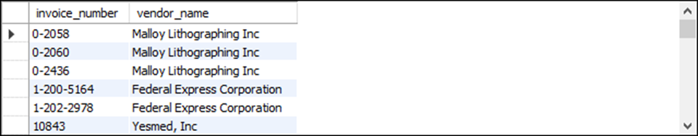
The explicit syntax for an inner join
SELECT select_list
FROM table_1
[INNER] JOIN table_2
ON join_condition_1
[[INNER] JOIN table_3
ON join_condition_2]...
An inner join of the Vendors and Invoices tables
SELECT invoice_number, vendor_name
FROM vendors INNER JOIN invoices
ON vendors.vendor_id = invoices.vendor_id
ORDER BY invoice_number
(114 rows)

Slide 5
The syntax for an inner join that uses table aliases
SELECT select_list
FROM table_1 a1
[INNER] JOIN table_2 a2
ON a1.column_name operator a2.column_name
[[INNER] JOIN table_3 a3
ON a2.column_name operator a3.column_name]...

Slide 6
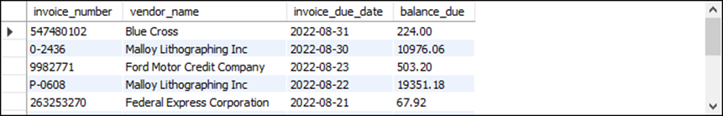
An inner join with aliases for all tables
SELECT invoice_number, vendor_name, invoice_due_date,
invoice_total - payment_total - credit_total
AS balance_due
FROM vendors v JOIN invoices i
ON v.vendor_id = i.vendor_id
WHERE invoice_total - payment_total - credit_total > 0
ORDER BY invoice_due_date DESC
(11 rows)

Slide 7
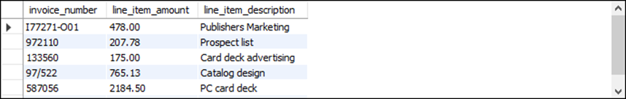
An inner join with an alias for only one table
SELECT invoice_number, line_item_amount,
line_item_description
FROM invoices JOIN invoice_line_items line_items
ON invoices.invoice_id = line_items.invoice_id
WHERE account_number = 540
ORDER BY invoice_date
(6 rows)

Slide 8
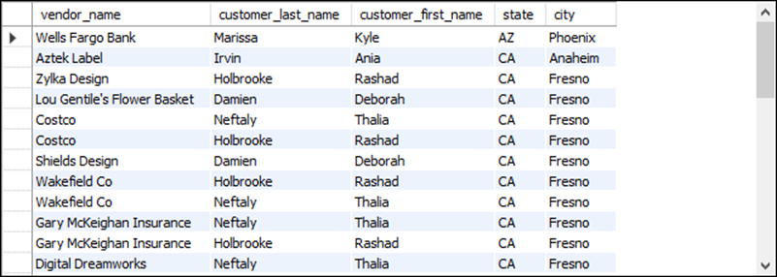
The syntax of a table name that’s qualified with a database name
database_name.table_name
A join to a table in another database
SELECT vendor_name, customer_last_name,
customer_first_name, vendor_state AS state,
vendor_city AS city
FROM vendors v
JOIN om.customers c
ON v.vendor_zip_code = c.customer_zip
ORDER BY state, city
(37 rows)

Slide 9
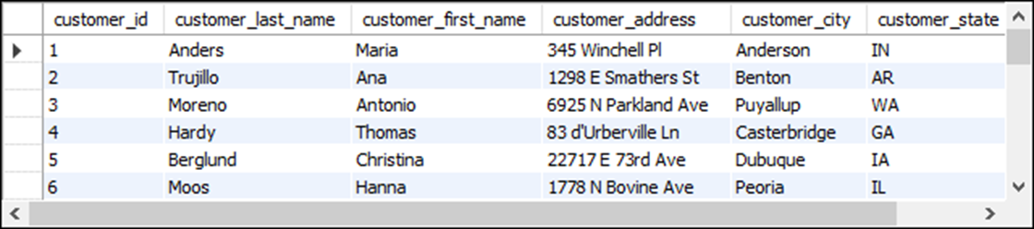
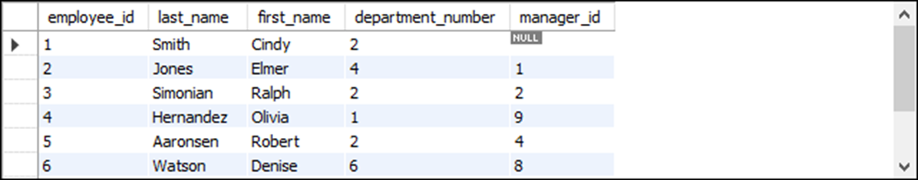
The Customers table
(24 rows)
The Employees table
(9 rows)

Slide 10
An inner join with two conditions
SELECT customer_first_name, customer_last_name
FROM customers c JOIN employees e
ON c.customer_first_name = e.first_name
AND c.customer_last_name = e.last_name
(1 row)

Slide 11
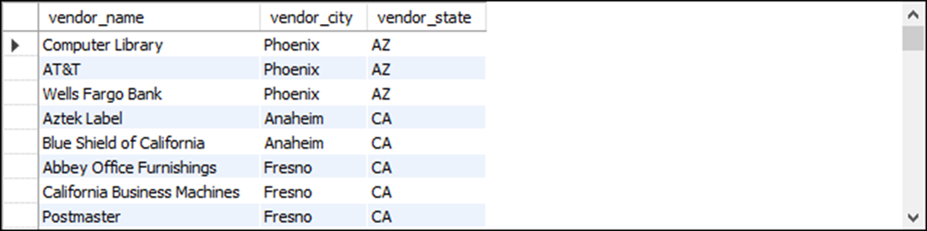
A self-join that returns vendors from cities in common with other vendors
SELECT DISTINCT v1.vendor_name, v1.vendor_city,
v1.vendor_state
FROM vendors v1 JOIN vendors v2
ON v1.vendor_city = v2.vendor_city AND
v1.vendor_state = v2.vendor_state AND
v1.vendor_name <> v2.vendor_name
ORDER BY v1.vendor_state, v1.vendor_city
(84 rows)

Slide 12
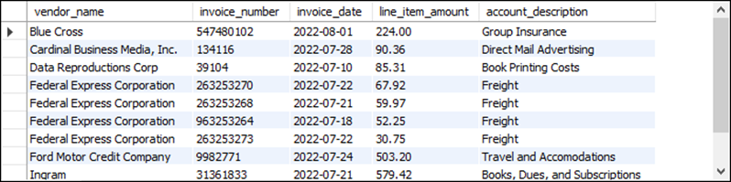
A statement that joins four tables
SELECT vendor_name, invoice_number, invoice_date,
line_item_amount, account_description
FROM vendors v
JOIN invoices i
ON v.vendor_id = i.vendor_id
JOIN invoice_line_items li
ON i.invoice_id = li.invoice_id
JOIN general_ledger_accounts gl
ON li.account_number = gl.account_number
WHERE invoice_total - payment_total - credit_total > 0
ORDER BY vendor_name, line_item_amount DESC
(11 rows)

Slide 13
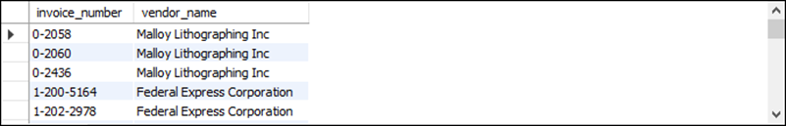
The implicit syntax for an inner join
SELECT select_list
FROM table_1, table_2 [, table_3]...
WHERE table_1.column_name operator table_2.column_name
[AND table_2.column_name operator table_3.column_name]...
Join the Vendors and Invoices tables
SELECT invoice_number, vendor_name
FROM vendors v, invoices i
WHERE v.vendor_id = i.vendor_id
ORDER BY invoice_number
(114 rows)

Slide 14
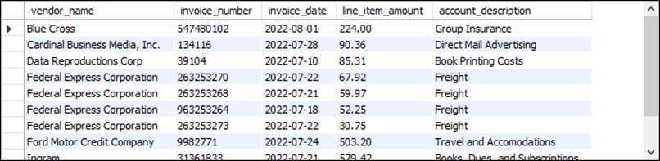
Join four tables
SELECT vendor_name, invoice_number, invoice_date,
line_item_amount, account_description
FROM vendors v, invoices i, invoice_line_items li,
general_ledger_accounts gl
WHERE v.vendor_id = i.vendor_id
AND i.invoice_id = li.invoice_id
AND li.account_number = gl.account_number
AND invoice_total - payment_total - credit_total > 0
ORDER BY vendor_name, line_item_amount DESC
(11 rows)

Slide 15
Terms to know about inner joins
Join
Join condition
Inner join
Ad hoc relationship
Qualified column name
Table alias
Schema
Self-join
Explicit syntax (SQL-92)
Implicit syntax

Slide 16
The explicit syntax for an outer join
SELECT select_list
FROM table_1
{LEFT|RIGHT} [OUTER] JOIN table_2
ON join_condition_1
[{LEFT|RIGHT} [OUTER] JOIN table_3
ON join_condition_2]...
What outer joins do
Joins of this type Retrieve unmatched rows from
Left outer join The first (left) table
Right outer join The second (right) table

Slide 17
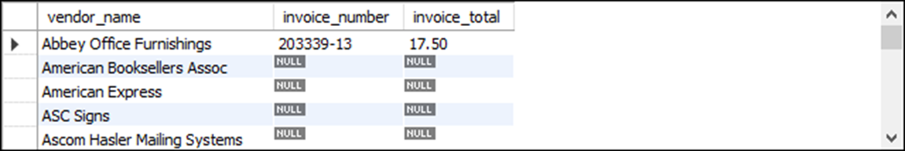
A left outer join of the Vendors and Invoices tables
SELECT vendor_name, invoice_number, invoice_total
FROM vendors LEFT JOIN invoices
ON vendors.vendor_id = invoices.vendor_id
ORDER BY vendor_name
(202 rows)

Slide 18
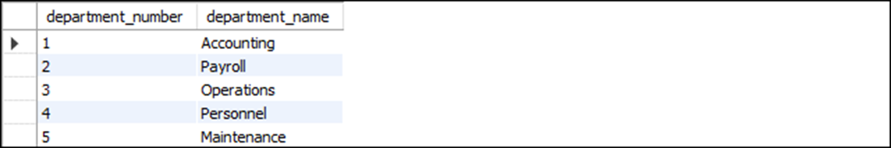
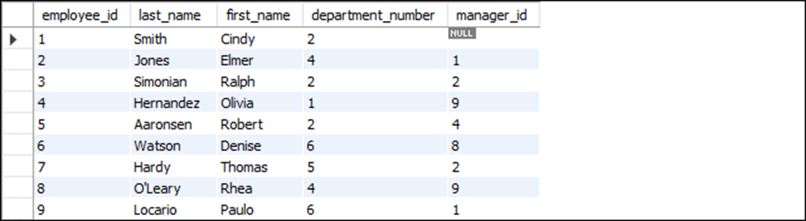
The Departments table
The Employees table

Slide 19
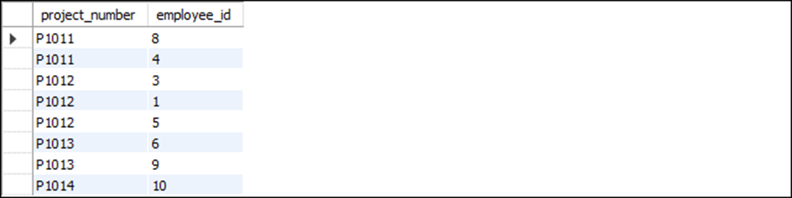
The Projects table

Slide 20
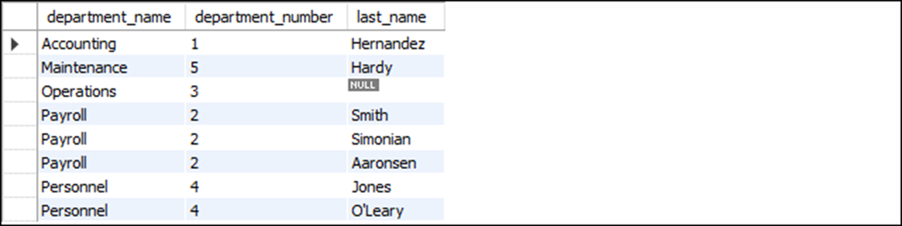
A left outer join
SELECT department_name, d.department_number, last_name
FROM departments d
LEFT JOIN employees e
ON d.department_number = e.department_number
ORDER BY department_name
(8 rows)

Slide 21
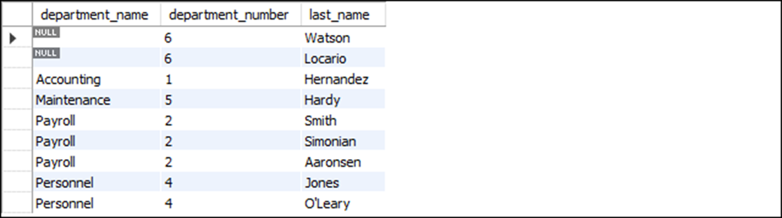
A right outer join
SELECT department_name, e.department_number, last_name
FROM departments d
RIGHT JOIN employees e
ON d.department_number = e.department_number
ORDER BY department_name
(9 rows)

Slide 22
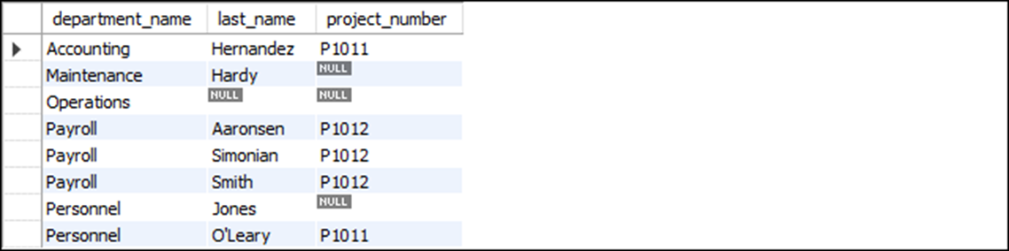
Join three tables using left outer joins
SELECT department_name, last_name, project_number
FROM departments d
LEFT JOIN employees e
ON d.department_number = e.department_number
LEFT JOIN projects p
ON e.employee_id = p.employee_id
ORDER BY department_name, last_name
(8 rows)

Slide 23
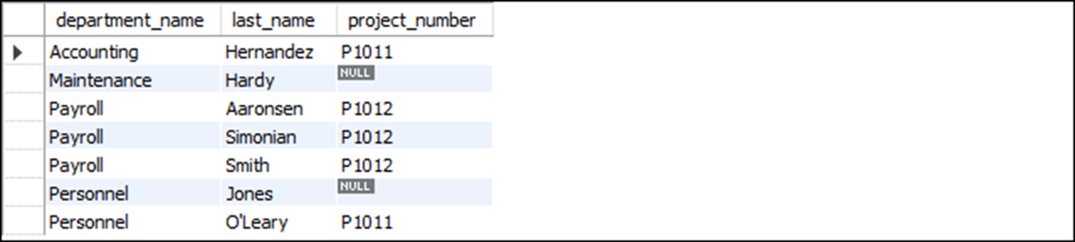
Combine an outer and an inner join
SELECT department_name, last_name, project_number
FROM departments d
JOIN employees e
ON d.department_number = e.department_number
LEFT JOIN projects p
ON e.employee_id = p.employee_id ORDER BY department_name, last_name
(7 rows)

Slide 24
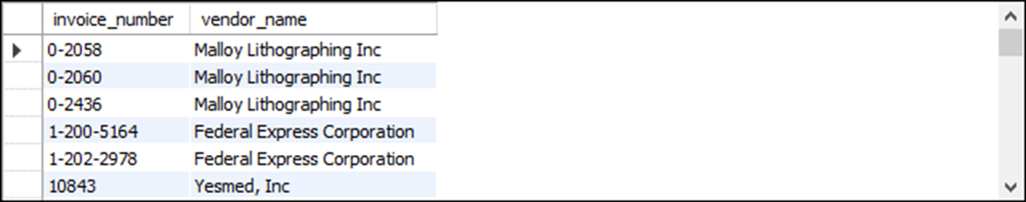
The syntax for a join that uses the USING keyword
SELECT select_list
FROM table_1
[{LEFT|RIGHT} [OUTER]] JOIN table_2
USING (join_column_1[, join_column_2]...)
[[{LEFT|RIGHT} [OUTER]] JOIN table_3
USING (join_column_1[, join_column_2]...)]...
Use the USING keyword to join two tables
SELECT invoice_number, vendor_name
FROM vendors
JOIN invoices USING (vendor_id)
ORDER BY invoice_number
(114 rows)

Slide 25
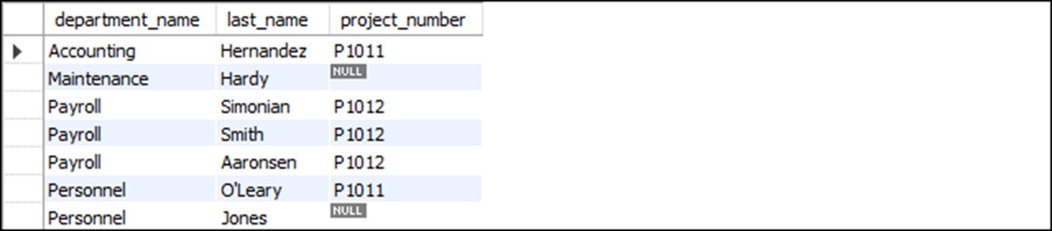
Use the USING keyword to join three tables
SELECT department_name, last_name, project_number
FROM departments
JOIN employees USING (department_number)
LEFT JOIN projects USING (employee_id)
ORDER BY department_name
(7 rows)

Slide 26
The syntax for a join that uses the NATURAL keyword
SELECT select_list
FROM table_1
NATURAL JOIN table_2
[NATURAL JOIN table_3]...
Use the NATURAL keyword to join tables
SELECT invoice_number, vendor_name
FROM vendors
NATURAL JOIN invoices
ORDER BY invoice_number
(114 rows)

Slide 27
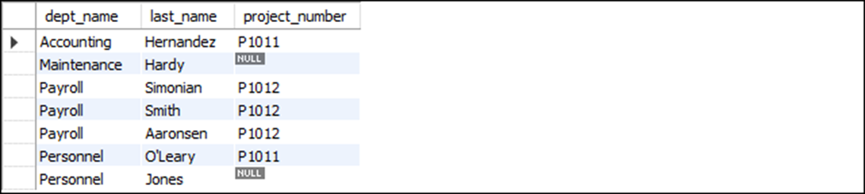
Use the NATURAL keyword in a statement that joins three tables
SELECT department_name AS dept_name, last_name, project_number
FROM departments
NATURAL JOIN employees
LEFT JOIN projects USING (employee_id)
ORDER BY department_name
(7 rows)

Slide 28
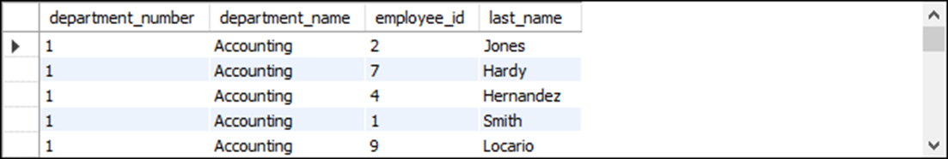
The explicit syntax for a cross join
SELECT select_list FROM table_1 CROSS JOIN table_2
A cross join that uses the explicit syntax
SELECT departments.department_number, department_name,
employee_id, last_name
FROM departments CROSS JOIN employees
ORDER BY departments.department_number
(45 rows)

Slide 29

The implicit syntax for a cross join
SELECT select_list FROM table_1, table_2
A cross join that uses the implicit syntax
SELECT departments.department_number, department_name,
employee_id, last_name
FROM departments, employees
ORDER BY departments.department_number
(45 rows)

Slide 30
Terms to know about other types of joins
Outer join
Left outer join
Right outer join
Equijoin
Natural join
Cross join
Cartesian product

Slide 31
The syntax for a union operation
SELECT_statement_1
UNION [ALL]
SELECT_statement_2
[UNION [ALL]
SELECT_statement_3]...
[ORDER BY order_by_list]
Rules for a union
• Each result set must return the same number of columns.
• The corresponding columns in each result set must have compatible data types.
• The column names in the final result set are taken from the first SELECT clause.

Slide 32
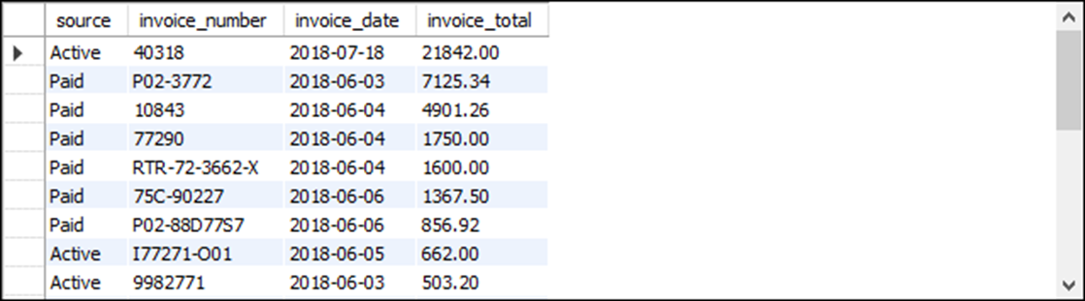
A union that combines result sets from two different tables
SELECT 'Active' AS source, invoice_number,
invoice_date, invoice_total
FROM active_invoices
WHERE invoice_date >= '2022-06-01'
UNION
SELECT 'Paid' AS source, invoice_number,
invoice_date, invoice_total
FROM paid_invoices
WHERE invoice_date >= '2022-06-01'
ORDER BY invoice_total DESC
(22 rows)

Slide 33
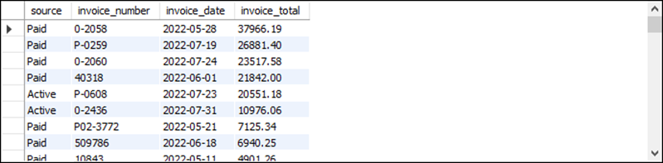
A union that combines result sets from a single table
SELECT 'Active' AS source, invoice_number,
invoice_date, invoice_total
FROM invoices
WHERE invoice_total - payment_total - credit_total > 0
UNION
SELECT 'Paid' AS source, invoice_number,
invoice_date, invoice_total
FROM invoices
WHERE invoice_total - payment_total - credit_total <= 0
ORDER BY invoice_total DESC
(114 rows)

Slide 34
A union that combines result sets from the same two tables
SELECT invoice_number, vendor_name,
'33% Payment' AS payment_type,
invoice_total AS total,
invoice_total * 0.333 AS payment
FROM invoices JOIN vendors
ON invoices.vendor_id = vendors.vendor_id
WHERE invoice_total > 10000
UNION
SELECT invoice_number, vendor_name,
'50% Payment' AS payment_type,
invoice_total AS total,
invoice_total * 0.5 AS payment
FROM invoices JOIN vendors
ON invoices.vendor_id = vendors.vendor_id
WHERE invoice_total BETWEEN 500 AND 10000

Slide 35
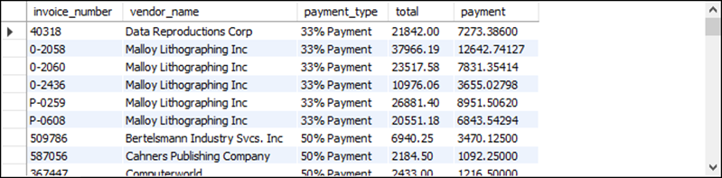
A union that combines result sets from the same two tables (continued)
UNION
SELECT invoice_number, vendor_name,
'Full amount' AS payment_type,
invoice_total AS total,
invoice_total AS payment
FROM invoices JOIN vendors
ON invoices.vendor_id = vendors.vendor_id
WHERE invoice_total < 500
ORDER BY payment_type, vendor_name, invoice_number
(114 rows)

Slide 36
A union that simulates a full outer join
SELECT department_name AS dept_name,
d.department_number AS d_dept_no,
e.department_number AS e_dept_no, last_name
FROM departments d
LEFT JOIN employees e
ON d.department_number = e.department_number
UNION
SELECT department_name AS dept_name,
d.department_number AS d_dept_no,
e.department_number AS e_dept_no, last_name
FROM departments d
RIGHT JOIN employees e
ON d.department_number = e.department_number
ORDER BY dept_name

Slide 37
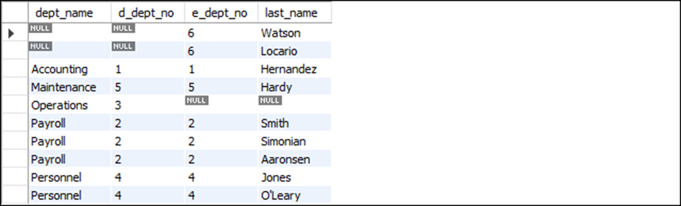
A union that simulates a full outer join (result set)
(10 rows)

Slide 38
Terms to know about unions
Union
Full outer join

